Slide 1
WATERMARKING OF GRAYSCALE TEXT DOCUMENT IMAGES USING HISTOGRAM SWAPPING
Paper ID: CSIT-19MY2012-243
Jayanth Silesh,
Anvitha Jaishankar,
Rashmi N
Dept. Information Science & Engg.
BNM Institute of Technology,
VTU, Bangalore, India.

Slide 2
FLOW OF THE HISTOGRAM SWAPPING ALGORITHM
Step 1: Input the original image, Secret Keys & bits to embed.
Step 2: Calculate the histogram.
Step 3: Apply the ‘embed’ rule for all secret keys on the histogram.
Step 4: Save the watermarked Image.

Slide 3
RULE FOR SECRET KEYS & BITS…
The no. of bits that can be embedded must always range from 1 to 16.
Conditions:
    If the histogram bins have a non-zero values, maximum of the range can be selected.
The no. of Secret keys must be equal to the no. of bits that are embedded.
The keys selected must always be in steps of (minimum)4 & cannot be consecutive numbers.

Slide 4
HISTOGRAM CREATION
Histograms are calculated based on the intensities.
The bins are created by ranging the intensities in steps of 6.
EXAMPLE:
0 1 2 3 4 5 6 7 8 9 10 11 12 13..17 .. 168 169..173 ..246 247.. 251…..
HIST(1) HIST(2) HIST(3) HIST(29) HIST(42)
Thus, we get a total of 43 bins.
The last bin is always ignored. i.e. 43rd

Slide 5
EMBED RULE
Based on the secret keys the histograms are swapped.
Each key is taken and their corresponding histogram & its consecutive histogram values are checked.
If they are equal, keys must be incremented by 1 until the condition is satisfied.
Rule for bit 0:
    Hist (key [i] ) < Hist (key[i] +1 ) //Remains unchanged
Otherwise, the histograms are swapped
Rule for bit 1
    Hist (key [i] ) > Hist (key[i] +1 ) //Remains unchanged
      Otherwise, the histograms are swapped
Notes:
Talk about how to calculate the intensities & how the intensities are swapped…

Slide 6
SWAPPING..
The swapping rule goes as follows:
Say the key entered by user is ‘A’ then,
consider two variables:
INTENSITY1= (A-1)*6
INTENSITY2=((A+1)-1)*6
INTENSITY1+1
INTENSITY1+2
INTENSITY1+3
INTENSITY1+4
INTENSITY1+5
INTENSITY2+1
INTENSITY2+2
INTENSITY2+3
INTENSITY2+4
INTENSITY2+5

Slide 7
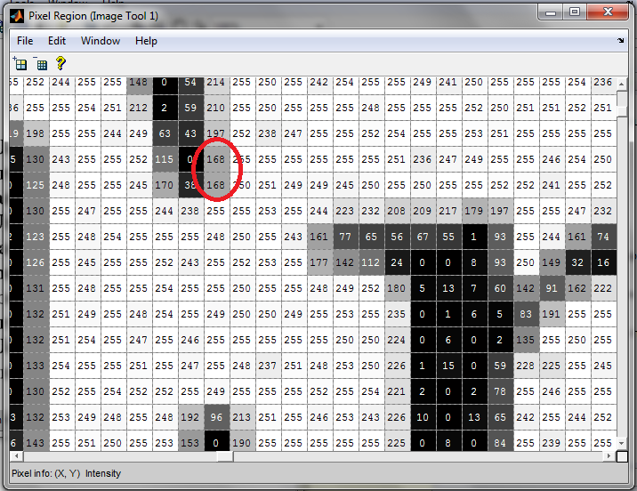
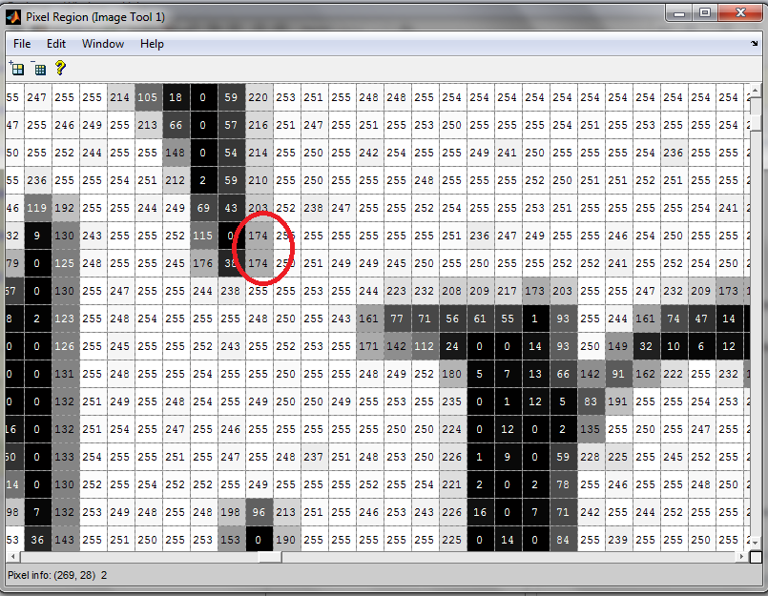
Fig1:
The intensities values of the Original Image
Fig2: The intensities values of the Watermarked Image.

Slide 8
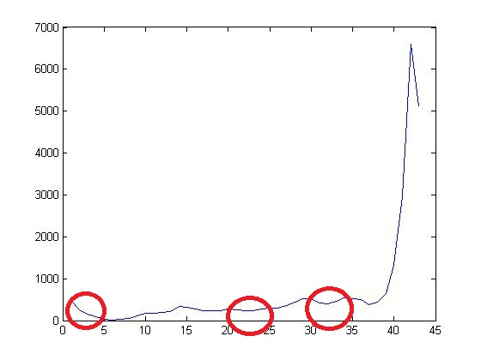
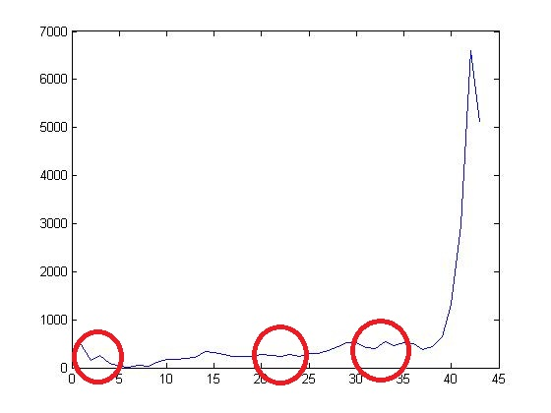
HISTOGRAMS…
Fig 1: Original-Histogram Fig 2: Watermarked-Histogram
Worst Case: Minor Changes to the Histogram, as shown in the above Fig.
Best Case: No changes to the Histogram.
Histogram changes depends on the Image & the signals that are embedded.

Slide 9
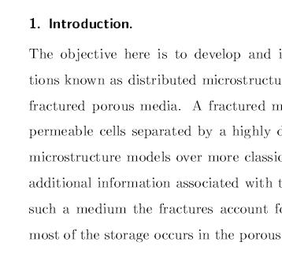
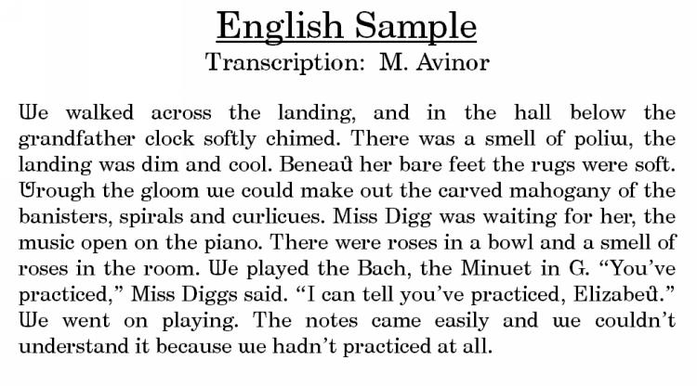
Fig1: Original Image
Fig2: Watermarked Image

Slide 10
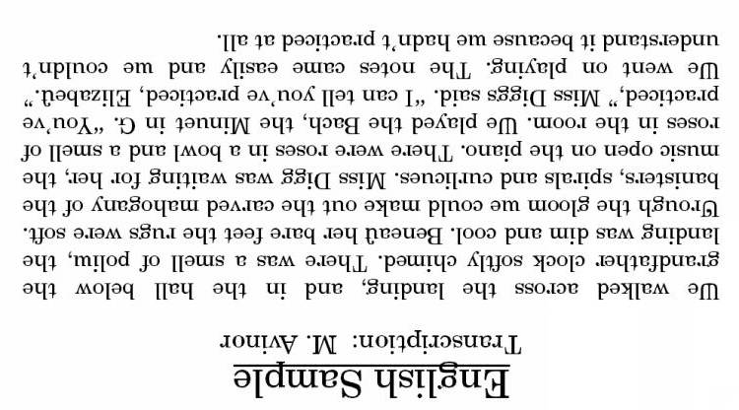
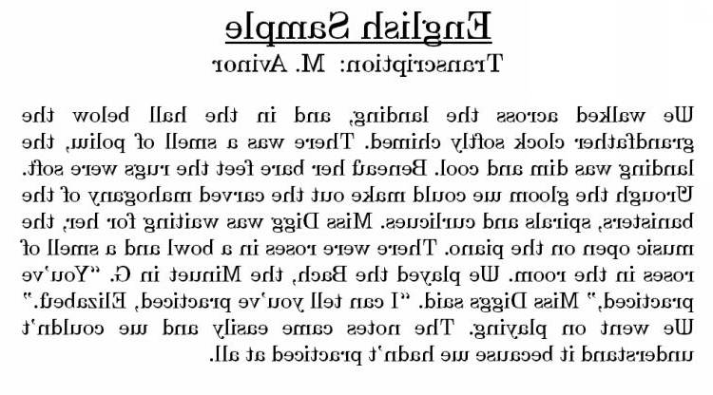
ATTACKS- FLIPPING, ROTATING
Fig1: Flipped
Fig2: Rotated by 180
Attack | Encoded bits | Decoded bits | Accuracy
Flipped Horizontally | 1 0 1 0 1 0 1 0 0 1 0 1 0 1 0 1 | 1 0 1 0 1 0 1 0 0 1 0 1 0 1 0 1 | 100% 100%
Rotated by 90 | 1 0 1 0 1 0 1 0 0 1 0 1 0 1 0 1 | 1 0 1 0 1 0 1 0 0 1 0 1 0 1 0 1 | 100% 100%
180˚ rotate | 1 0 1 0 1 0 1 0 0 1 0 1 0 1 0 1 | 1 0 1 0 1 0 1 0 0 1 0 1 0 1 0 1 | 100% 100%
Flipped vertically | 1 0 1 0 1 0 1 0 0 1 0 1 0 1 0 1 | 1 0 1 0 1 0 1 0 0 1 0 1 0 1 0 1 | 100% 100%

Slide 11
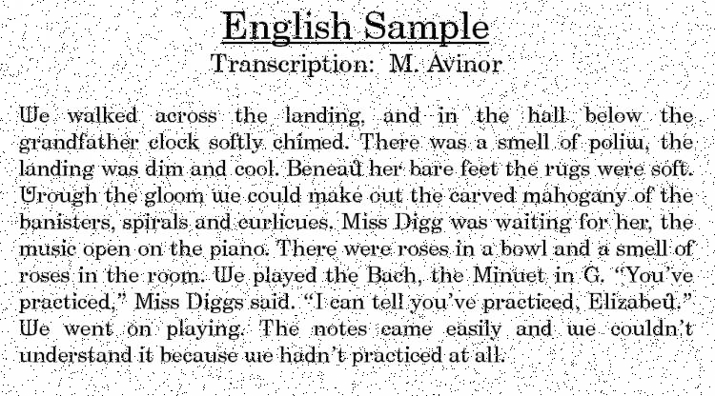
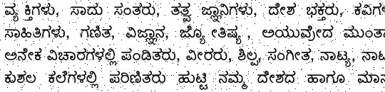
ATTACK- NOISE (SALT & PEPPER 0.02)
Image 1
Image 2
 | Noise | Encoded Signal | Decoded Signal | Accuracy
Image1 | 0.02 | 1 0 1 0 1 0 1 0 | 1 0 1 0 1 0 1 0 | 100%
 | 0.02 | 0 1 0 1 0 1 0 1 | 0 1 0 1 0 1 0 1 | 100%
Image2 | 0.02 | 1 0 1 0 1 0 1 0 | 1 0 1 0 0 0 1 0 | 87.5%
 | 0.02 | 0 1 0 1 0 1 0 1 | 0 1 0 1 0 1 0 1 | 100%

Slide 12
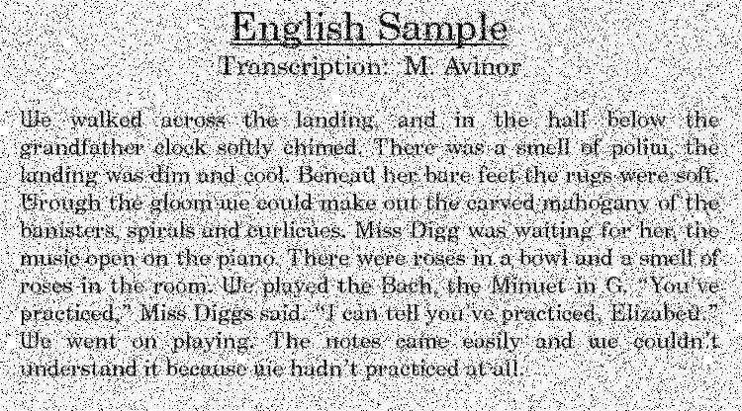
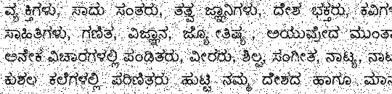
ATTACK- NOISE (SALT & PEPPER 0.08)
Image 1
Image 2
 | Noise | Encoded Signal | Decoded Signal | Accuracy
Image1 | 0.08 | 1 0 1 0 1 0 1 0 | 1 0 1 0 1 0 1 0 | 100%
 | 0.08 | 0 1 0 1 0 1 0 1 | 0 1 0 1 0 1 0 1 | 100%
Image2 | 0.08 | 1 0 1 0 1 0 1 0 | 1 0 1 0 1 1 1 0 | 87.5%
 | 0.08 | 0 1 0 1 0 1 0 1 | 0 1 0 1 0 1 0 1 | 100%

Slide 13
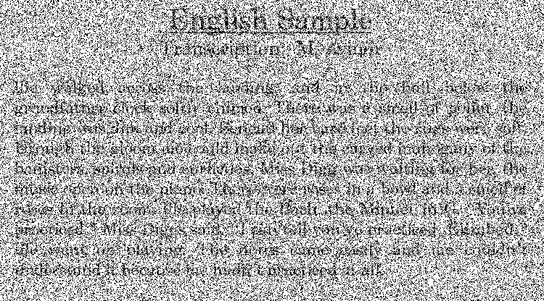
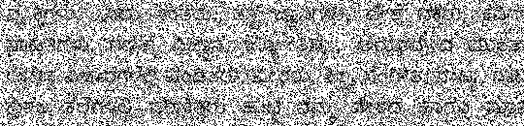
ATTACK- NOISE (SALT & PEPPER 0.5)
Image 1
Image 2
 | Noise | Encoded Signal | Decoded Signal | Accuracy
Image1 | 0.5 | 1 0 1 0 1 0 1 0 | 1 0 1 0 1 1 1 0 | 87.5%
 | 0.5 | 0 1 0 1 0 1 0 1 | 0 1 0 1 0 1 0 1 | 100%
Image2 | 0.5 | 1 0 1 0 1 0 1 0 | 0 0 1 0 0 1 1 0 | 62.5%
 | 0.5 | 0 1 0 1 0 1 0 1 | 0 1 0 1 1 1 0 1 | 87.5%

Slide 14
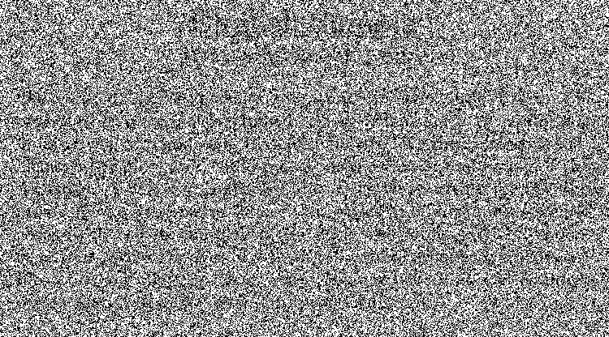
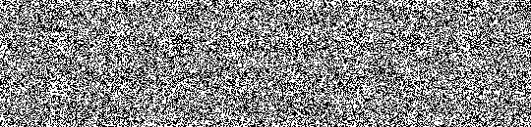
ATTACK- NOISE (SALT & PEPPER 0.8)
Image 1
Image 2
 | Noise | Encoded Signal | Decoded Signal | Accuracy
Image1 | 0.8 | 1 0 1 0 1 0 1 0 | 1 1 1 0 1 0 0 0 | 75%
 | 0.8 | 0 1 0 1 0 1 0 1 | 0 1 0 1 1 1 0 1 | 87.5%
Image2 | 0.8 | 1 0 1 0 1 0 1 0 | 1 0 1 0 1 0 1 0 | 100%
 | 0.8 | 0 1 0 1 0 1 0 1 | 0 1 0 1 0 1 1 1 | 62.5%

Slide 15
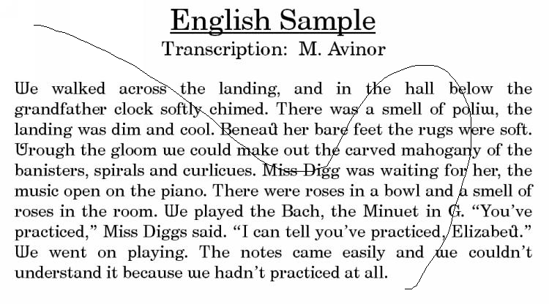
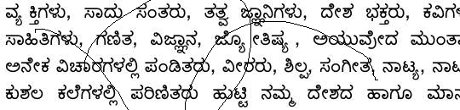
ATTACK- TAMPERING(1ST DEGREE)
Image 1
Image 2
 | Encoded Signal | Decoded Signal | PSNR | Accuracy
Image 1 | 1 0 1 0 1 0 1 0 | 1 0 1 0 1 0 1 0 | 21.4516 | 100%
Image 2 | 0 1 0 1 0 1 0 1 | 0 1 0 1 0 0 0 1 | 21.0073 | 87.5%

Slide 16
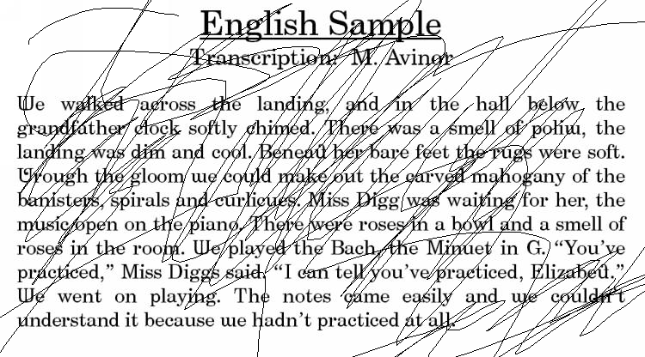
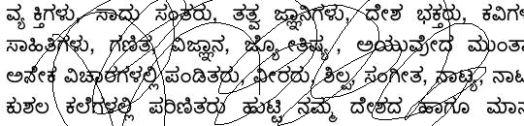
ATTACK- TAMPERING(2ND DEGREE)
Image 1
Image 2
 | Encoded Signal | Decoded Signal | PSNR | Accuracy
Image 1 | 1 0 1 0 1 0 1 0 | 1 0 1 0 1 0 1 0 | 14.0178 | 100%
Image 2 | 0 1 0 1 0 1 0 1 | 0 1 0 1 0 0 0 1 | 14.8338 | 87.5%

Slide 17
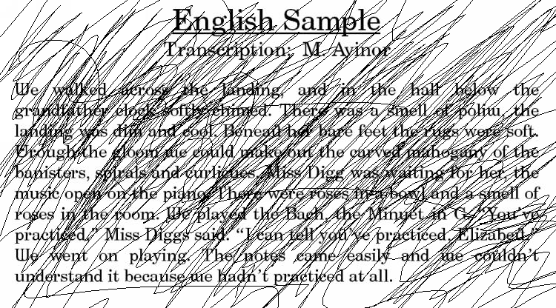
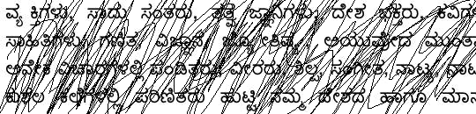
ATTACK- TAMPERING(3RD DEGREE)
Image 1
Image 2
 | Encoded Signal | Decoded Signal | PSNR | Accuracy
Image 1 | 1 0 1 0 1 0 1 0 | 1 0 1 0 1 0 1 0 | 8.9003 | 100%
Image 2 | 0 1 0 1 0 1 0 1 | 1 1 0 1 0 0 0 1 | 8.3261 | 75%

Slide 18
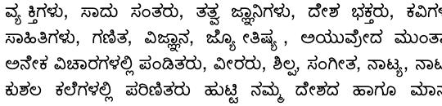
TESTING FOR ALL INPUTS
Encoded Signal | Decoded Signal | PNSR | Time Taken
1111 | 1111 | 44.1195 | 1.2595
1110 | 1110 | 50.2830 | 0.8951
1101 | 1101 | 43.6039 | 1.6860
1100 | 1100 | 48.4616 | 1.2950
1011 | 1011 | 44.7821 | 0.9089
1010 | 1010 | 54.1027 | 0.5219
1001 | 1001 | 44.1872 | 1.3530
1000 | 1000 | 50.5701 | 0.8952
0111 | 0111 | 44.5789 | 0.9251
0110 | 0110 | 52.6113 | 0.5097
0101 | 0101 | 44.0094 | 1.3016
0100 | 0100 | 49.8452 | 0.9041
0011 | 0011 | 45.3222 | 0.5105
0010 | 0010 | Infinity | 0.0784
0001 | 0001 | 44.6543 | 0.8935
0000 | 0000 | 53.1142 | 0.5176

Slide 19
ADVANTAGES
The watermarking scheme is imperceptible.
Applicable to all image sizes.
It is robust against geometrical attacks like rotation, flipping, aspect ratio changes and resizing, shifting.
Good resistance to image tampering.
Blind watermarking.
Reversible.

Slide 20
THANK YOU!

